Slide 1
Roads To New Lands Update
Trent McLaughlin, P.Eng.

Slide 2
Process for Land Owners

Slide 3
Progress
2013 5.4 Kilometers Approved
2014 18.0 Kilometers Approved
2015 9.8 Kilometers Approved.
In Progress 25.5 Kilometers or to Start in 2016

Slide 4
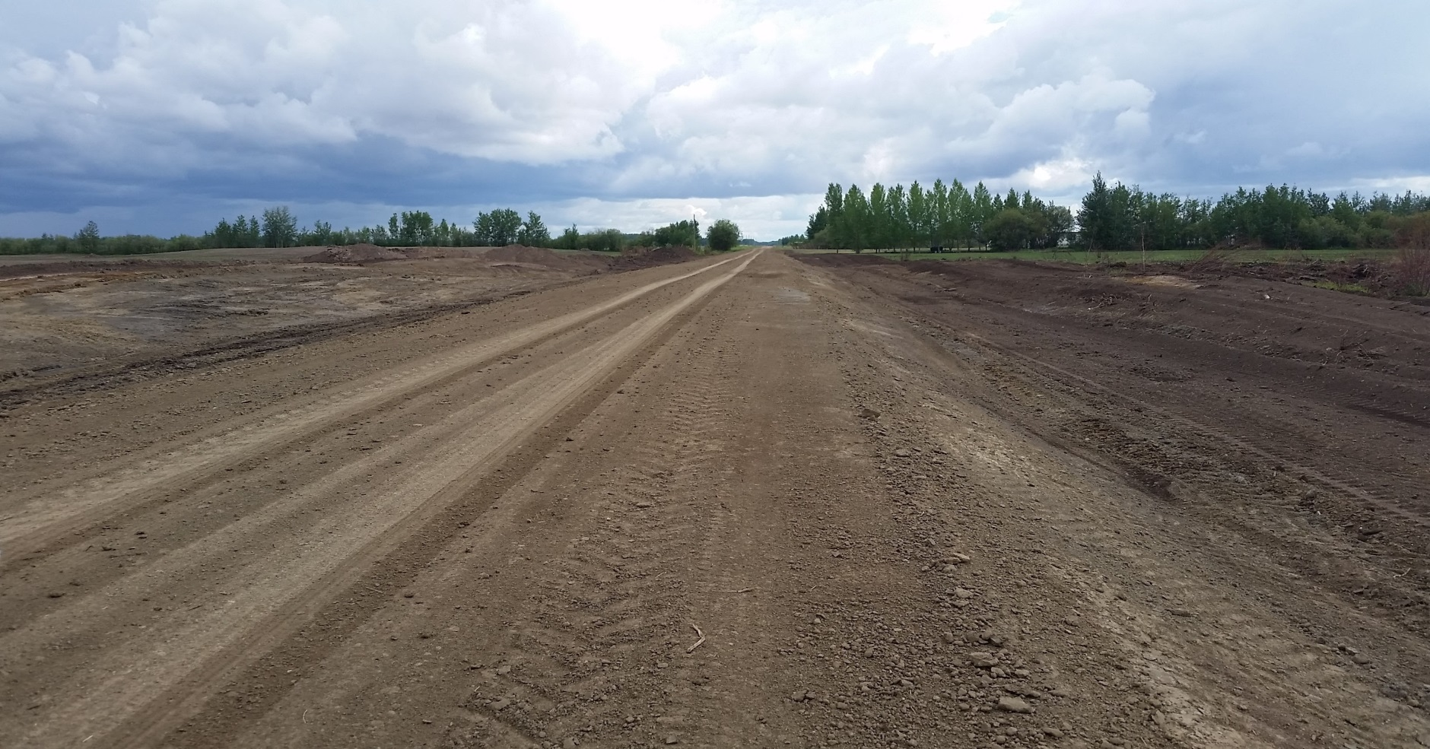
Notes:
S½ 14 & W½ 13 104 14 W5M √ 1525 meters of road Complete June 2015 Buffalo Head Mennonite School

Slide 5
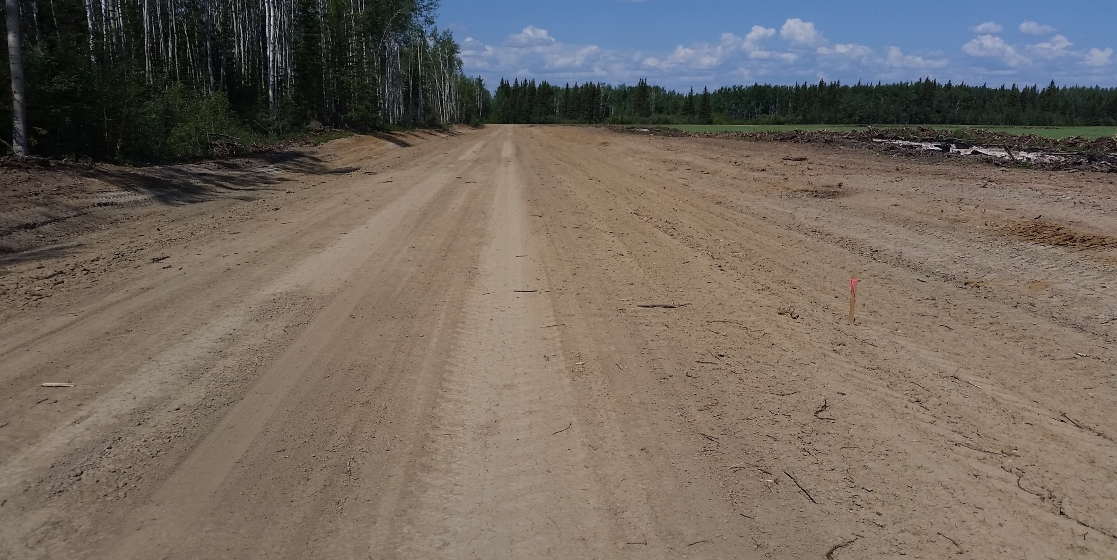
Notes:
SE 14 104 16 W5M √ 800 meters of road Complete July 2015 SIMPSON, John

Slide 6
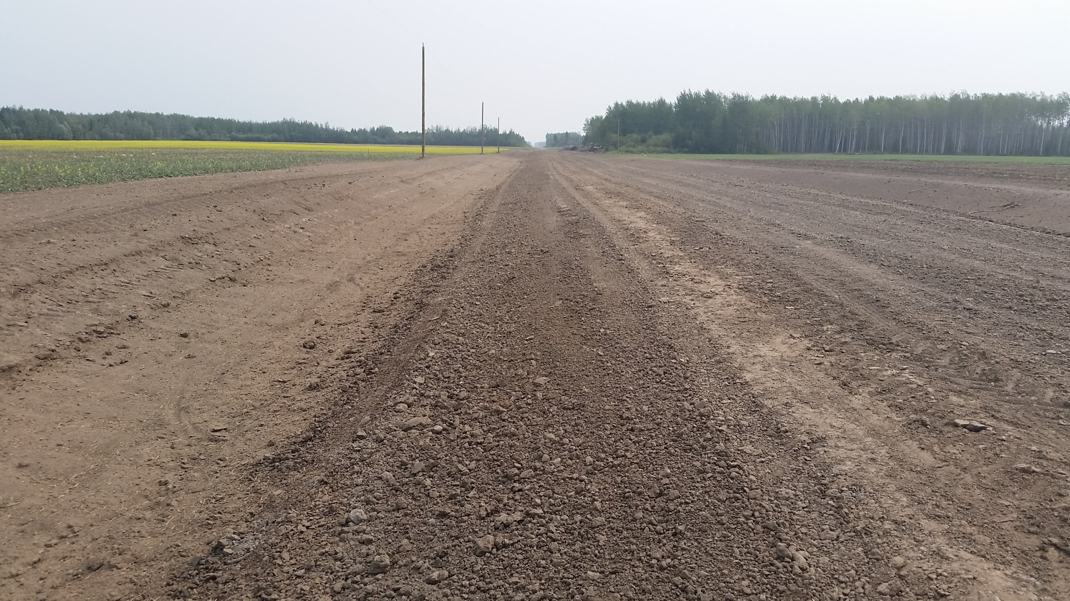
Notes:
NW 14 106 12 W5M √ 350 meters of road Complete July 2015 BOEHLIG, Nick

Slide 7
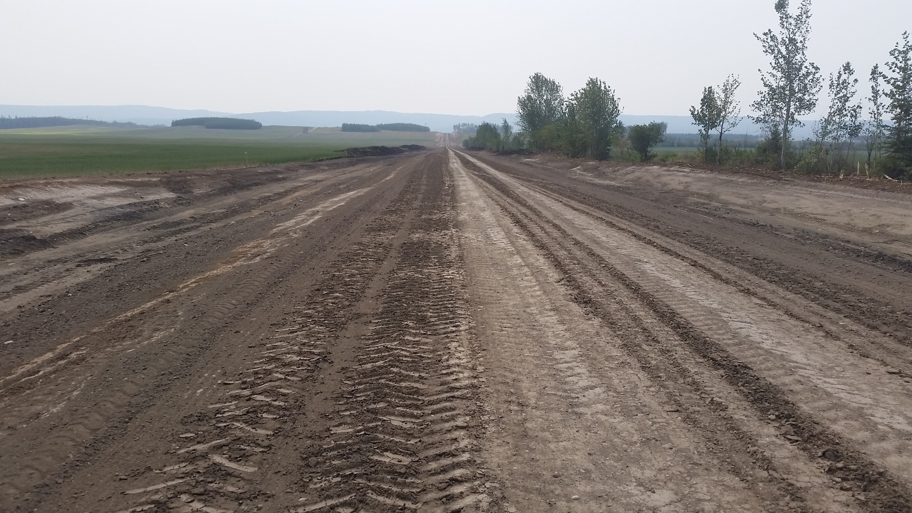
Notes:
NE 3 104 15 W5M √ 1700 meters of road In Progress PETERS, Martin (Ernie Peters)

Slide 8
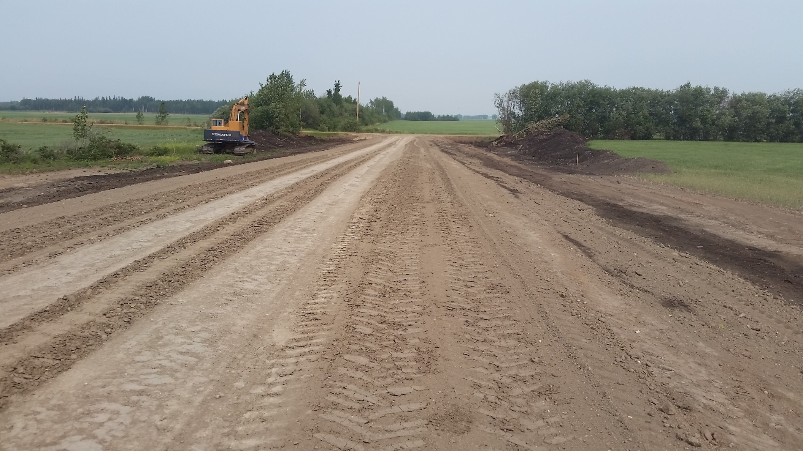
Notes:
NE 3 104 15 W5M √ 1700 meters of road Complete with conditions PETERS, Martin (Ernie Peters)

Slide 9
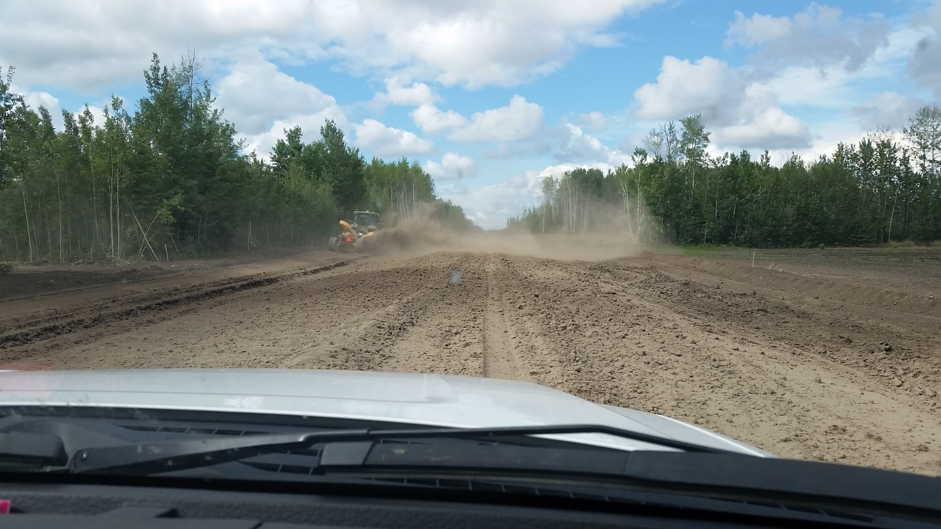
Notes:
NW 28 103 17 W5M √ 850 meters of road In Progress BRAUN, Martin

Slide 10
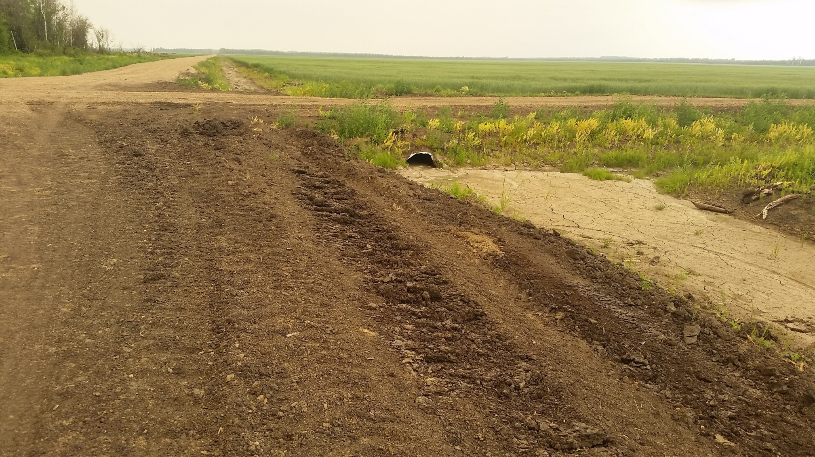
Notes:
NW 1 104 14 W5M √ 1670 meters of road Complete July 2015 DRIEDGER, David

Slide 11
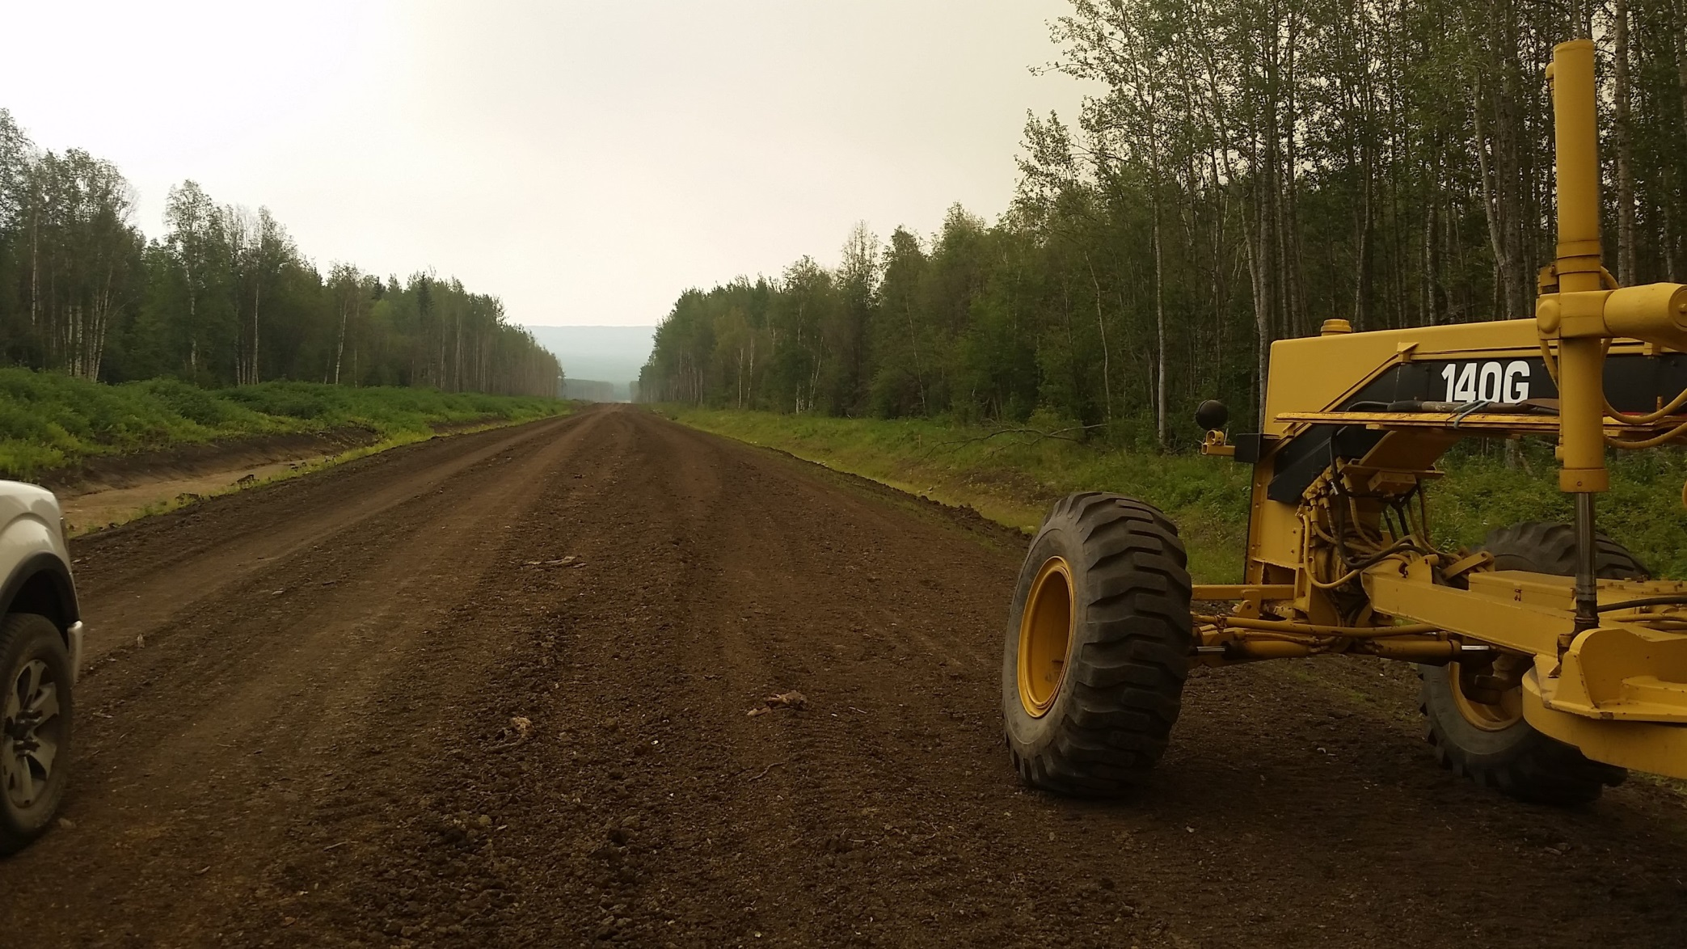
Notes:
NW 1 104 14 W5M √ 1670 meters of road Complete July 2015 DRIEDGER, David

Slide 12
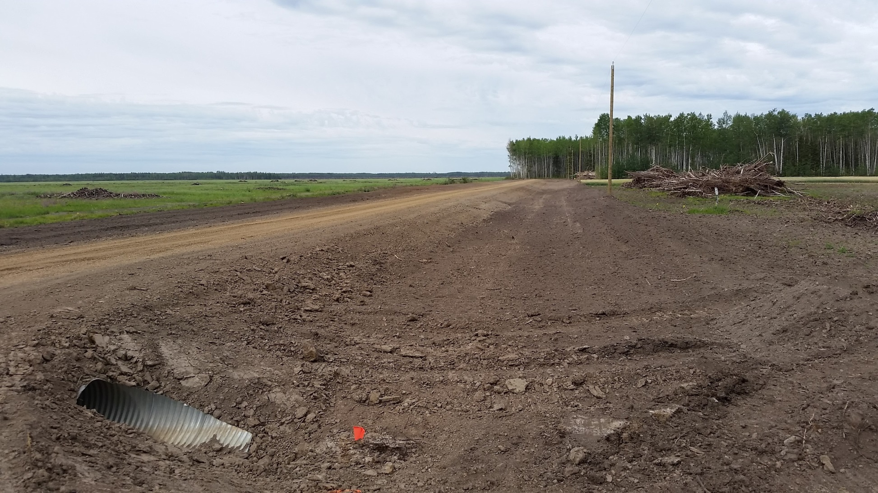
Notes:
SE 13 106 13 W5M √ 350 meters of road Complete July 2015 WALL, Willy

Slide 13
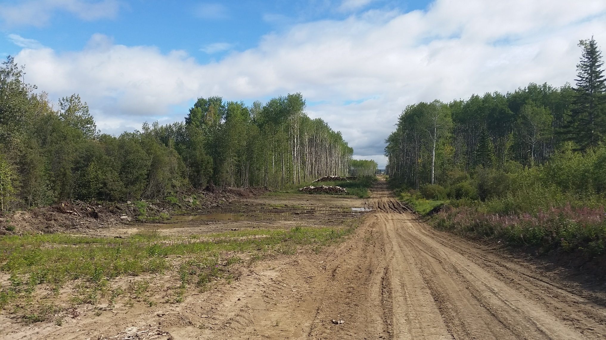
Notes:
Bennie Peters road, SE 15 102 18 W5M

Slide 14
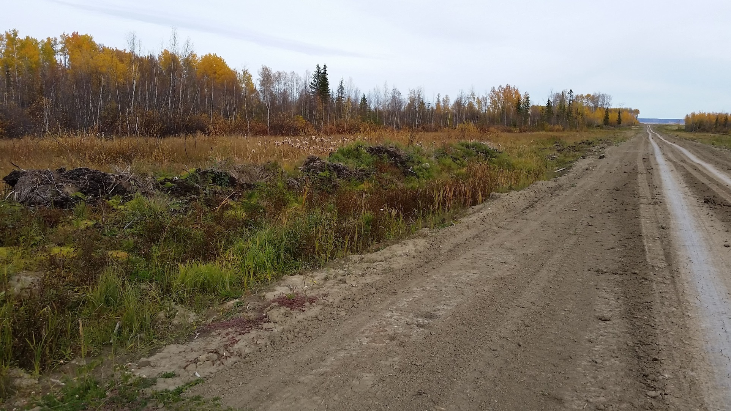
Notes:
S½ 18 103 18 ,S½ 13 103 19 W5M √ 3200 meters of road In Progress BRAUN, Ben

Slide 15
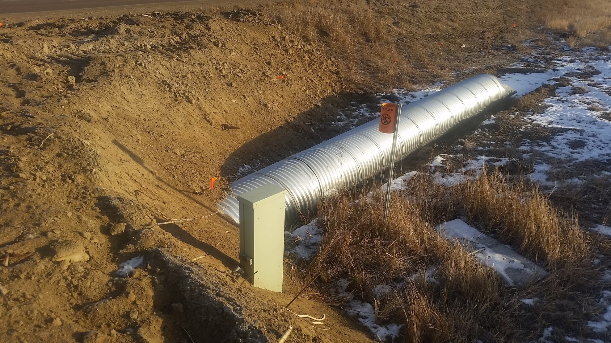
Notes:
SE 12 104 19 W5M √ 800 meters of road In Progress HARMS, Henry

Slide 16
Questions?

